Slide 1
Phoswich Optimization Analysis GATE and OCTAVE Processing
Bill Worstell
CapeSym
1/13/2022

Slide 2
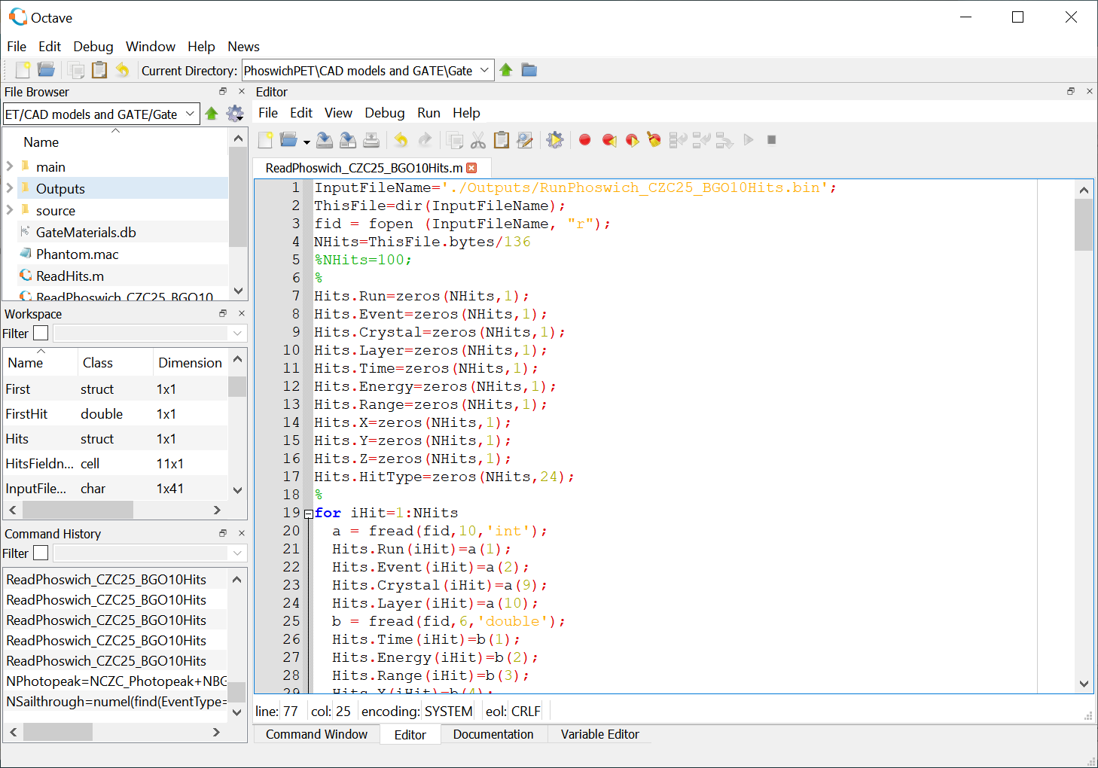
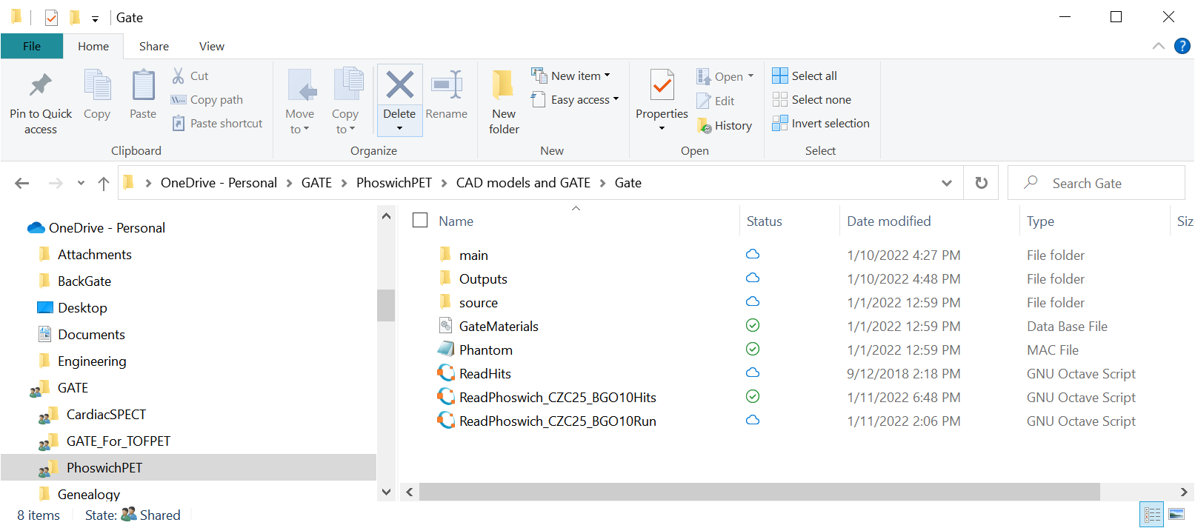
ReadPhoswich_CZC25_BGO10Hits.m

Slide 3
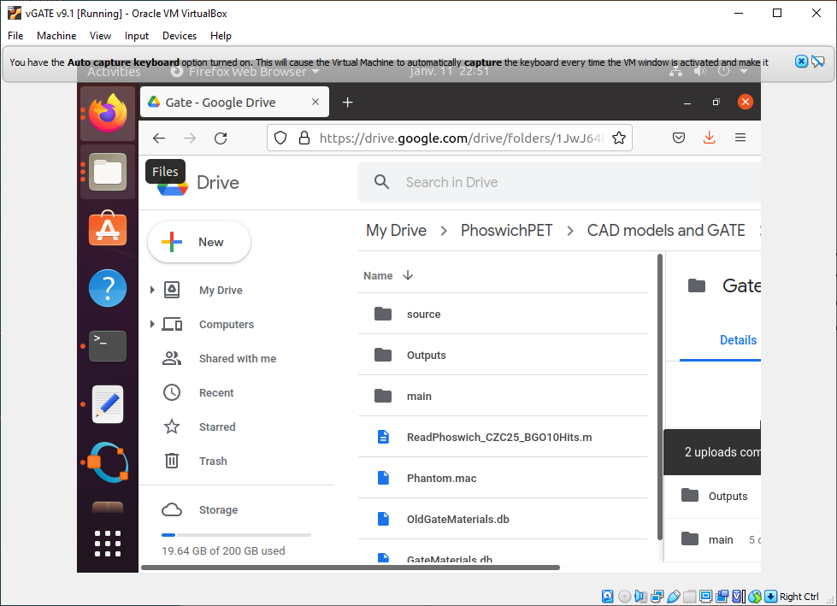
Virtual Machine
Google Drive Repository
RunPhoswich_CZC25_BGO10Hits.m

Slide 4
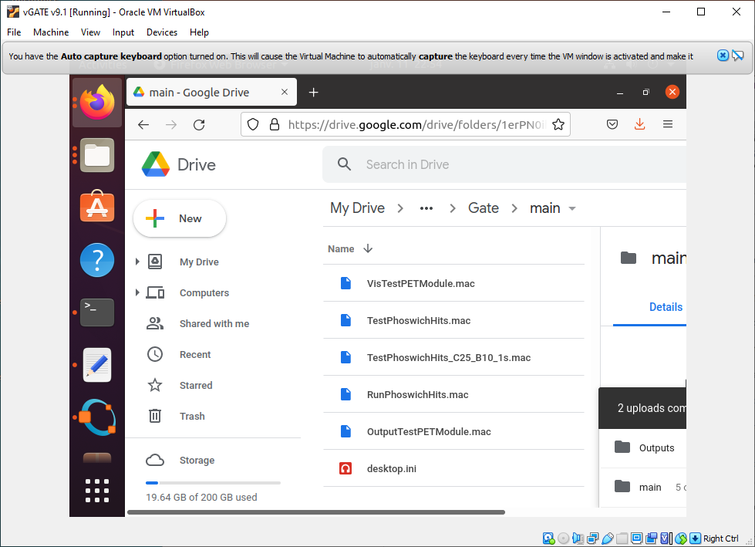
Virtual Machine
Google Drive Repository
RunPhoswichHits.mac

Slide 5
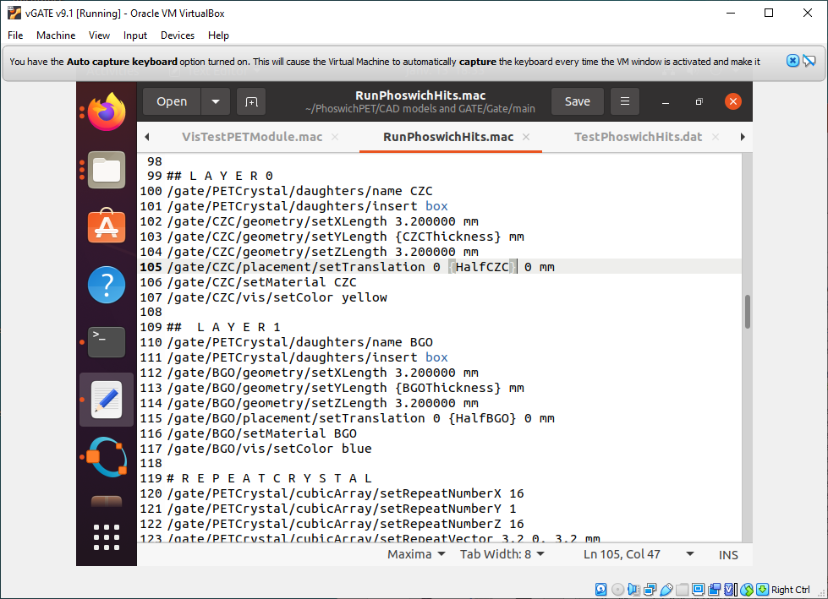
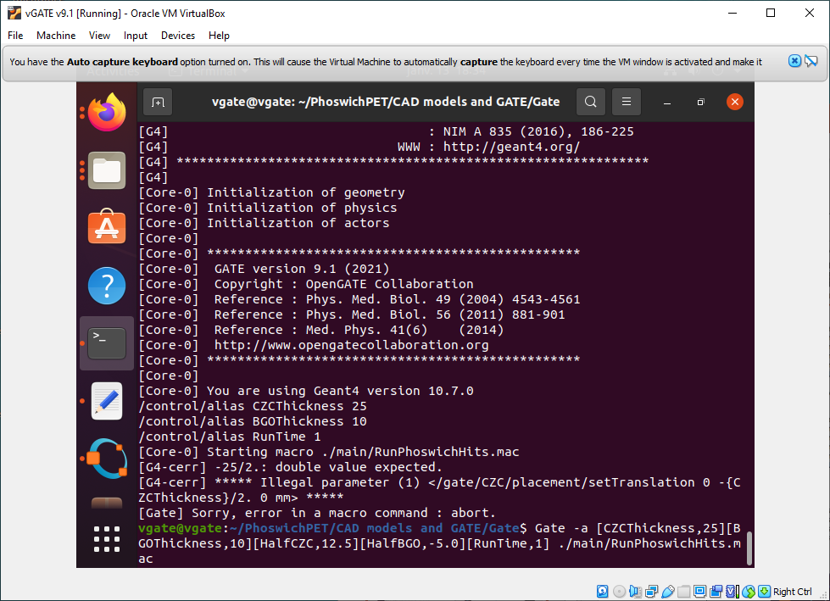
$Gate –a [CZCThickness,25][BGOThickness,10][HalfCZC,12.5][HalfBGO,-5.0][RunTime,1] ./main/RunPhoswichHits.mac

Slide 6
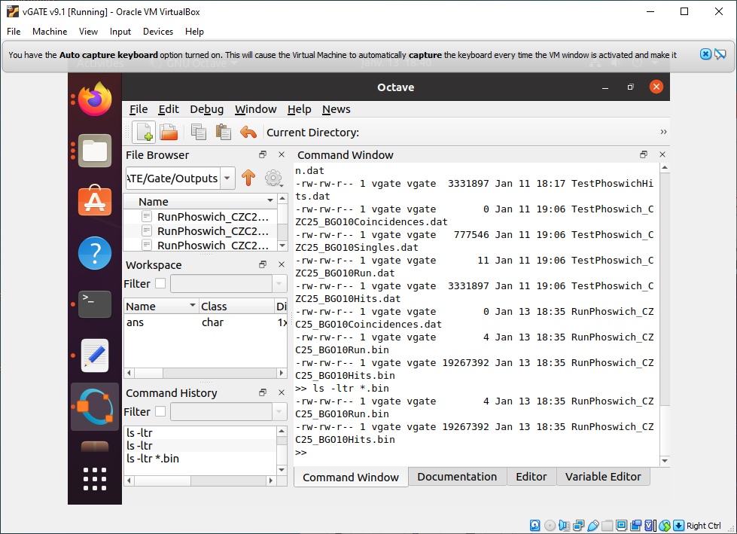
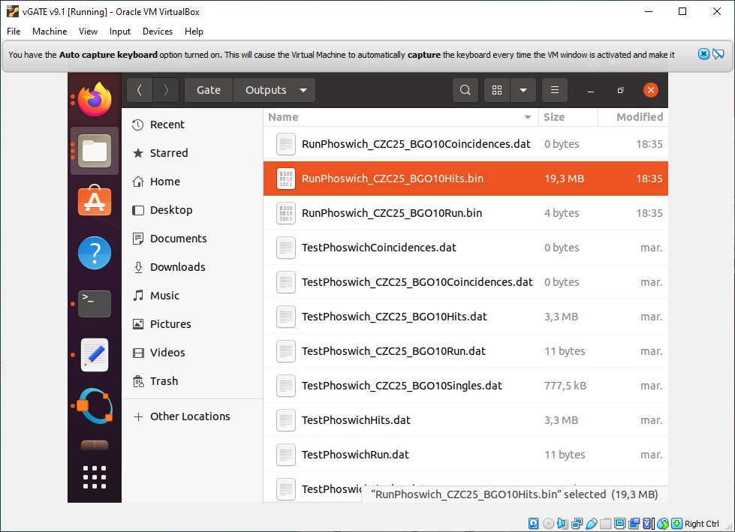
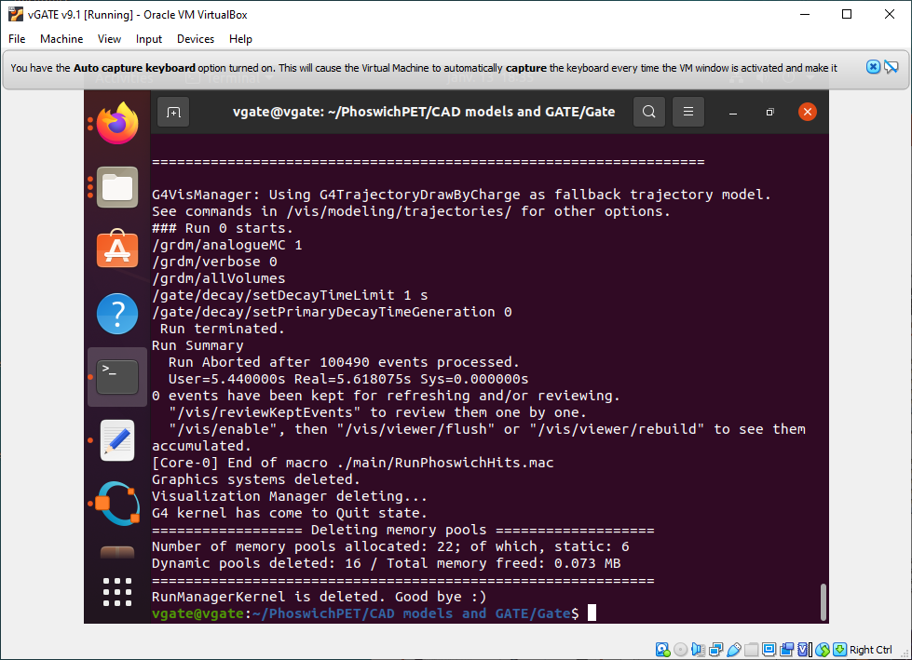
$Gate –a [CZCThickness,25][BGOThickness,10][HalfCZC,12.5][HalfBGO,-5.0][RunTime,1] ./main/RunPhoswichHits.mac

Slide 7
